Slide 1
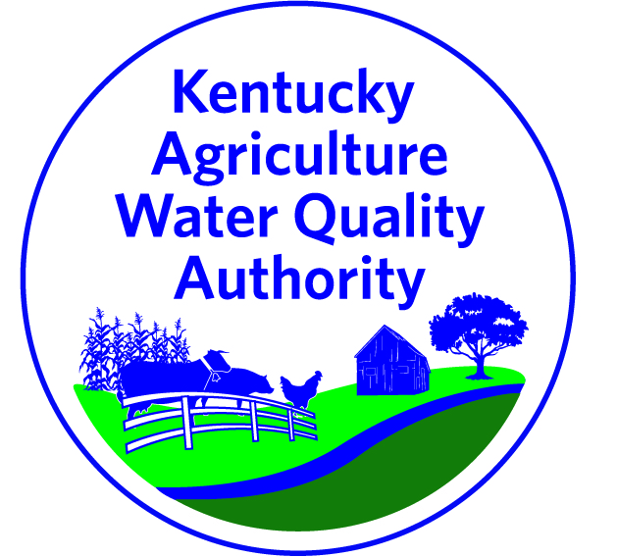
Kentucky Agriculture Water Quality Act
Protecting Water Quality on the Farm

Slide 2
Kentucky Agriculture Water Quality Act
Statute: KRS 224.71-100 through 224.71-145
10+ acres in agriculture or forestry must develop a water quality plan
Plan includes Best Management Practices (BMPs) to protect water quality
Established the Kentucky Ag Water Quality Authority
Multi-agency committee
Developed the KY Ag Water Quality State Plan
Tasked with reviewing BMPs, implementing the Act
Notes:
The KY Ag Water Quality Act was passed by the KY Legislature in 1994, and became fully enforceable in 2001. The law says anyone with 10 acres or more must develop and implement a water quality plan. Individual Agriculture Water Quality Plans are made up of selected best management practices (BMPs) to protect water quality based on the farming operation. The KY Ag Water Quality Authority is a multi-agency committee that meets quarterly to review BMPs and discuss current issues regarding water quality on the farm.

Slide 3
Who needs a plan?
Anyone farming or harvesting trees on 10+ acres
Anyone applying for federal, state, or local cost share
Federal: NRCS Environmental Quality Incentives Program (EQIP), etc.
State: Kentucky Soil Erosion and Water Quality Cost Share Program
Local: County Ag Investment Program (CAIP)
Notes:
Farming includes the production of livestock, livestock products, poultry, poultry products, milk, milk products or silviculture products or for the growing of crops such as but not limited to tobacco, corn, soybeans, small grains, fruits, and vegetables or devoted to and meeting the requirements and qualifications for payments to agriculture programs under an agreement with the state or federal government.

Slide 4
What is a plan?
A plan is the list of BMPs that have been and will be implemented on the farm to protect water quality
Livestock
Crops
Pesticides and Fertilizers
Farmstead
Forestry
Streams and Other Waters
Plans should be up-to-date and reflect current farm activities
Notes:
It is recommended that plans be updated at least every two years; updated more frequently if new land is acquired, new operations are developed, etc.

Slide 5
How is the KY Ag Water Quality Act enforced?
Division of Water is responsible for the enforcement of the Ag Water Quality Act
Direct owner/operator to seek technical assistance from the Conservation District.
Lack of AWQP or improper implementation
Corrective Measures process is followed
Water quality violation or imminent violation
90 day deadline, must contact Conservation District within 35 days
Timeline TBD: must contact Conservation District to develop a Corrective Measures Plan
Notify the local Conservation District of the issue.
Conduct a follow-up inspection unless the Conservation District notifies DOW that the issue has been resolved to its satisfaction

Slide 6
When would a farmer get a site visit from the Division of Water?
Complaints reported to the Division of Water
Inspectors visiting operations for routine inspection (permit holders)
Inspectors incidentally encounter a questionable operation

